Slide 1


Profiling a Canadian Internet Company
Presenters:
Brandon Curtis & Christopher Sigouin

Slide 2
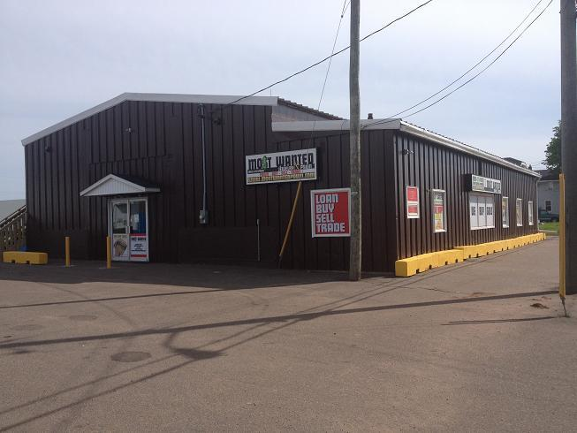
Our chosen business “ Most Wanted PEI Inc “
History Lesson, Background Information & Business Concepts
How it operates ( Electronically and Physically )
Social networking aspects of the business
Challenges that they face
Conclusion & Questions

Slide 3
Definition of a “ Pawn Broker “
A pawnbroker is an individual or business
(pawnshop or pawn shop) that offers secured
loans to people, with items of personal property
used as collateral.

Slide 4

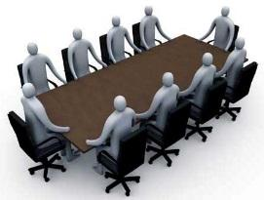
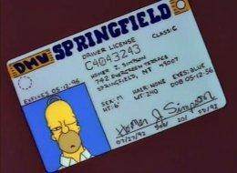

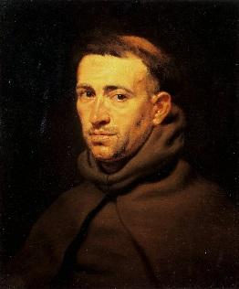

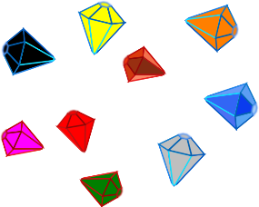
Pawn Broker History
“ Pawn “ is derived from the Latin work “ Pignus “
Oldest credit system ever!
Pawn Broker’s Symbol
1886
1872
1785
1603
1450
1338

Slide 5
Background & Business Concept
Most wanted is a pawn broker & shop that fills its shelves with wholesale, and pawned goods.
Target demographic is spread across 3 niche markets; Collectors, Consumers, and people with items to part with.
Unlike others, Most Wanted focuses on finding items that will fit easily into their niche market.

Slide 6



Business Helpers
National Pawn Brokers Association ( NPBA )
URL: http://www.nationalpawnbrokers.org/
Greater Charlottetown Chamber of Commerce
URL: http://www.charlottetownchamber.com/
Great Summerside Chamber of Commerce
URL: http://www.summersidechamber.com/

Slide 7
National Pawn Brokers Association
Advocacy
Compliance
Communications
Meetings & Events
Community Relations
Education
Firearms Resources
Discount on advertising rates in National Pawnbroker, the quarterly member magazine, and NPA Insider, the monthly member e-newsletter
Free listing on Pawn Industry Marketplace (located on the NPA website)
Discount on booth space at Pawn Expo, annual convention and tradeshow; based on availability
Copy of the NPA membership listing for marketing purposes; to be used one-time free of charge
NPA logo for use on website and marketing collateral
Eligible for Industry Partner of the Year Award

Slide 8
Greater Charlottetown Chamber of Commerce
Greater Summerside Chamber of Commerce
Canadian Chamber Group Health Plan
UPS Members Benefit Program for Chamber Members
Low Merchant Fee
Esso Gas Card
Spread the word, Promote Your Business - Exclusive to members
Credibility and Support of the Local Business Community
Advocacy - Together We Grow and Prosper
Cost Effective Education Opportunities
Networking Opportunities
Free for 1 year: Progress Magazine
Export Carnets & Certificates of Origin
Free GCACC logo to display
Group Insurance Plan
Reduce your shipping costs with UPS
‘First Data’ payment processing benefit
Esso Fuel Discount / Home Heating Discount
adAtlantic advertising discounts
iPolitics
Community Involvement
Educational Opportunities
Networking Opportunities
Free for 1 year: Progress Magazine
Free GSCC logo to display

Slide 9
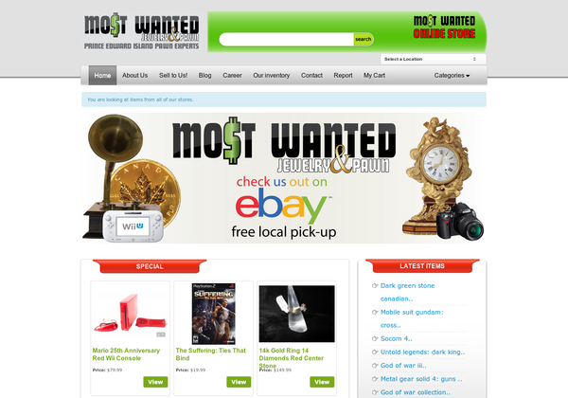
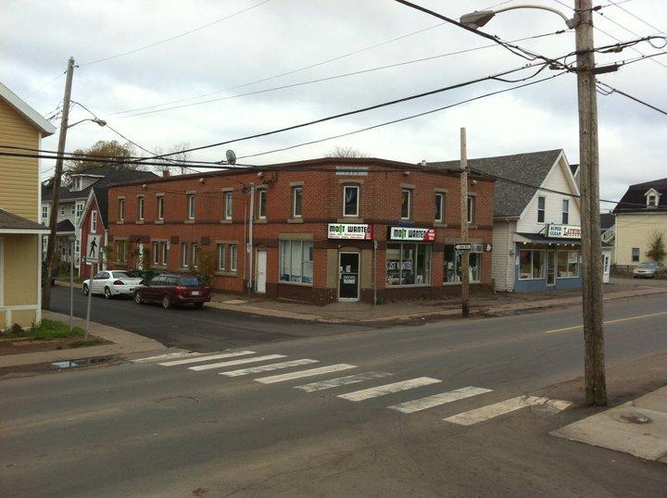
Operations Electronically & Physically

Slide 10
Physical Business Side
Offers pawn-based-loans, where users pawn items for a discussed amount, and must buy the item back in a period of time.
Buy and sell operations are handled carefully, prodding for potential stolen goods, and taking measures to assure items are in a state to re-sell.

Slide 11
Electronic Business Side
Overview of the website
Shopping location dropdown option
Single views of items
Multi views of items
Shopping cart view
Checkout Steps
MOST WANTED ONLINE STORE

Slide 12
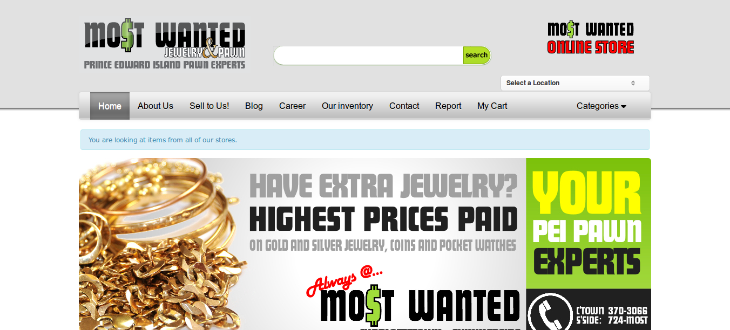
Overview: Location Dropdown

Slide 13
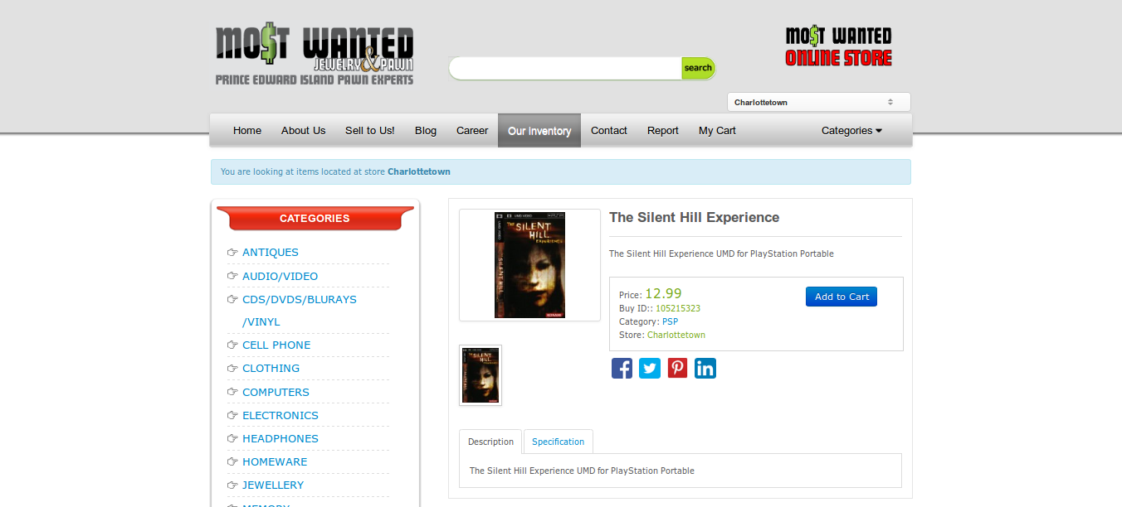
Overview: Single View

Slide 14
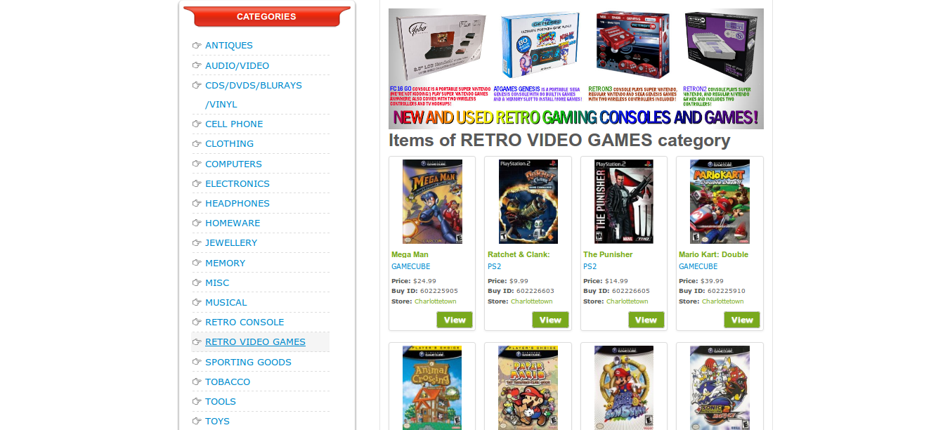
Overview: Multiple View

Slide 15
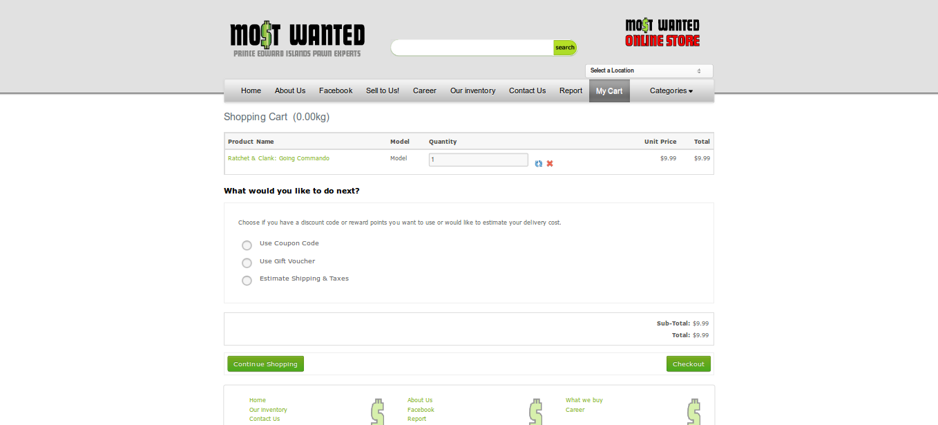
Overview: Shopping Cart

Slide 16
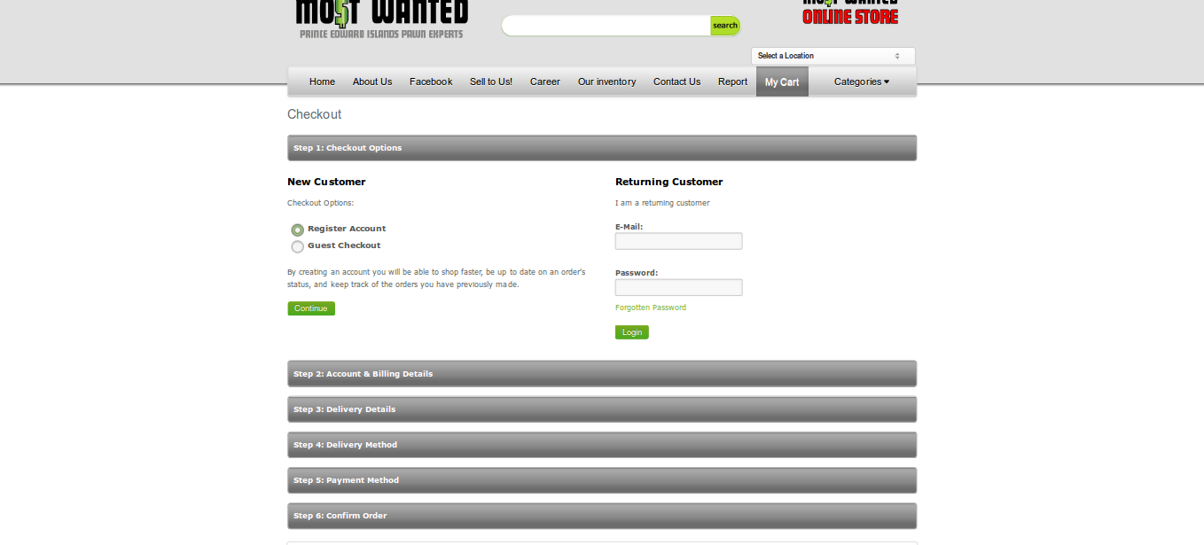
Overview: Checkout Options

Slide 17
Social Networking
What is social networking?
How does it help Most Wanted with their business?
MOST WANTED FACEBOOK PAGE
MOST WANTED BLOG

Slide 18
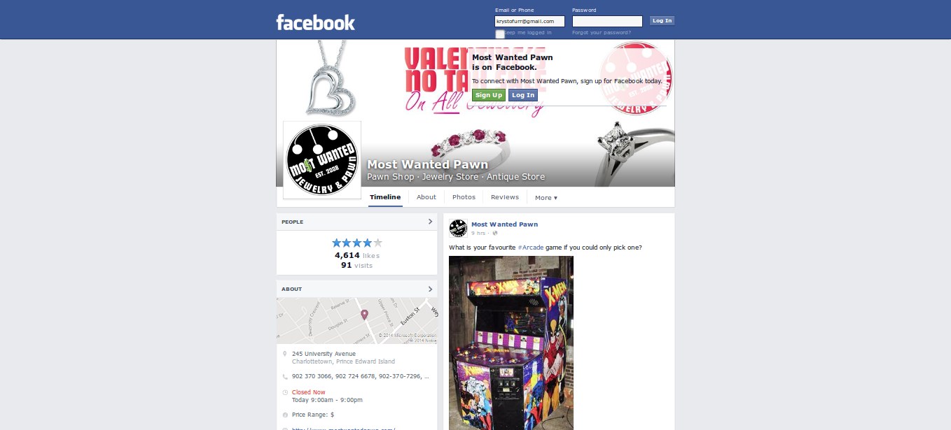
Social Networking: Facebook

Slide 19
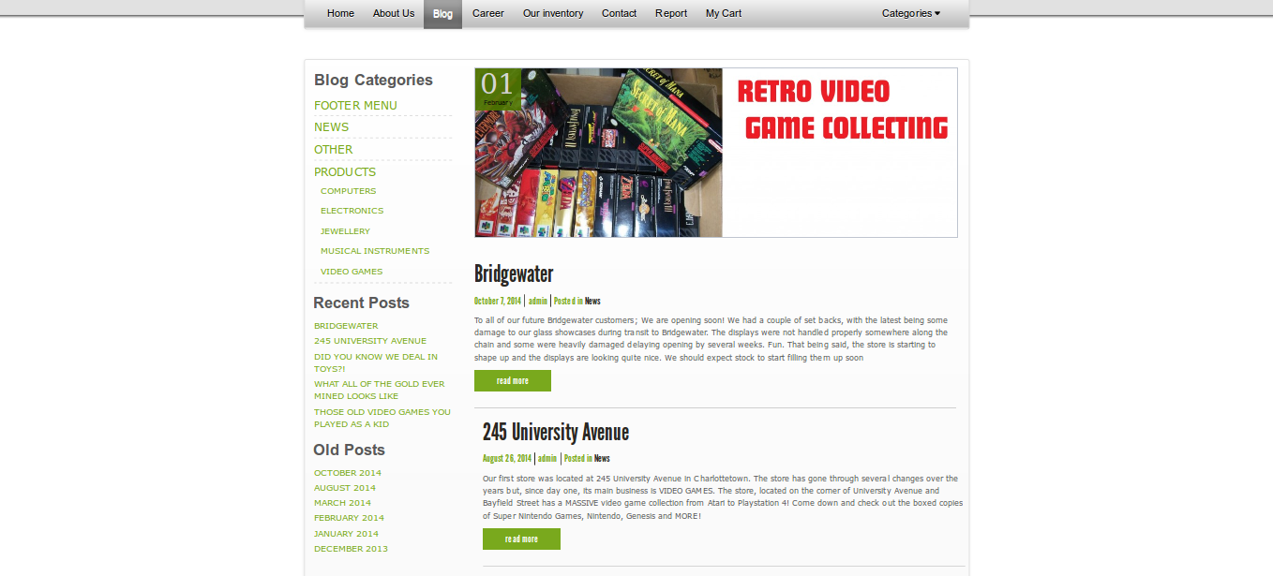
Social Networking: Blogging

Slide 20

Challenges Faced
Physical
Electronic
OTHER CHALLENGES:
Educating clients
Speed of Technology
“ We are out to get you! “
Tasks required by regulation
Local Competition
Customer Fraud
Updating Inventory
Employee Embezzlement
Active Social Media
Managing Inventory
Site Security

Slide 21

To sum it all up!
The business model will never die!
Support is available
E-Commerce options
Social networking aspects
Challenges are present, but can be lucrative

Slide 22
QUESTIONS ?!?!
COMMENTS ?!?!
Thanks for your time and attention!
Hope you enjoyed it.

Slide 23
REFERENCES ( Research Based )
http://mostwantedpawn.com/
Carter, S. P., & Skiba, P. M. (2012). Pawnshops, Behavioral Economics, and Self-Regulation.
http://en.wikipedia.org/wiki/History_of_pawnbroking
http://en.wikipedia.org/wiki/Pawnbroker - HISTORY
The Moral Economy By Laurence Fontaine - timeline help
http://www.thecanadianencyclopedia.ca/en/article/pawnbroking/
http://en.wikipedia.org/wiki/National_Pawnbrokers_Association
http://www.nationalpawnbrokers.org/
http://www.pawnmaster.com/pawn-challenges.php?p=Multi-StoreManagement ( CHALLENGES )
http://www.entrepreneur.com/article/241759 ( SUM IT UP )
http://listverse.com/2013/12/17/10-fascinating-facts-about-pawn-shops/ ( QUICK FACTS )

Slide 24
REFERENCES ( Research Based )
http://www.charlottetownchamber.com/
http://www.summersidechamber.com/

Slide 25
REFERENCES ( Picture based )
http://mostwantedpawn.com/
https://www.facebook.com/mostwantedpawn
http://www.charlottetownchamber.com/
http://www.summersidechamber.com
http://www.clker.com/cliparts/m/D/C/Q/6/Z/gems-hi.png ( JEWELS )
http://upload.wikimedia.org/wikipedia/commons/e/ea/Rubens,_Pieter_Paul_-_Head_of_a_Franciscan_Monk.jpg ( MONK )
http://i.huffpost.com/gen/313287/thumbs/s-HOMER-SIMPSON-large.jpg ( LICENSE )
http://www.townofdover.ca/siteupload/Committee.jpg ( COMMITTEE )
http://sustainablepeterborough.ca/wp-content/uploads/2012/02/canada-wordmark1.jpg( CAN FED )

